Slide 1
Embedded Network Design
Adam Hussain Ioannis Anastasiou Matt King

Slide 2
Project Aims
Temperature and light sensors
Manual control of heating and lighting
Integral display of key system data
Intrusion detection mechanisms and access control
Logging of system data with time (so as to allow time histories of temperature and light levels)
Intelligent monitoring systems to switch lights and heating off in unoccupied areas
Wireless communication between different units (e.g. between an entry unit and a room unit)

Slide 3
Project Outcomes
Temperature and light sensors
Manual control of heating and lighting
Integral display of key system data
Intrusion detection mechanisms and access control

Slide 4
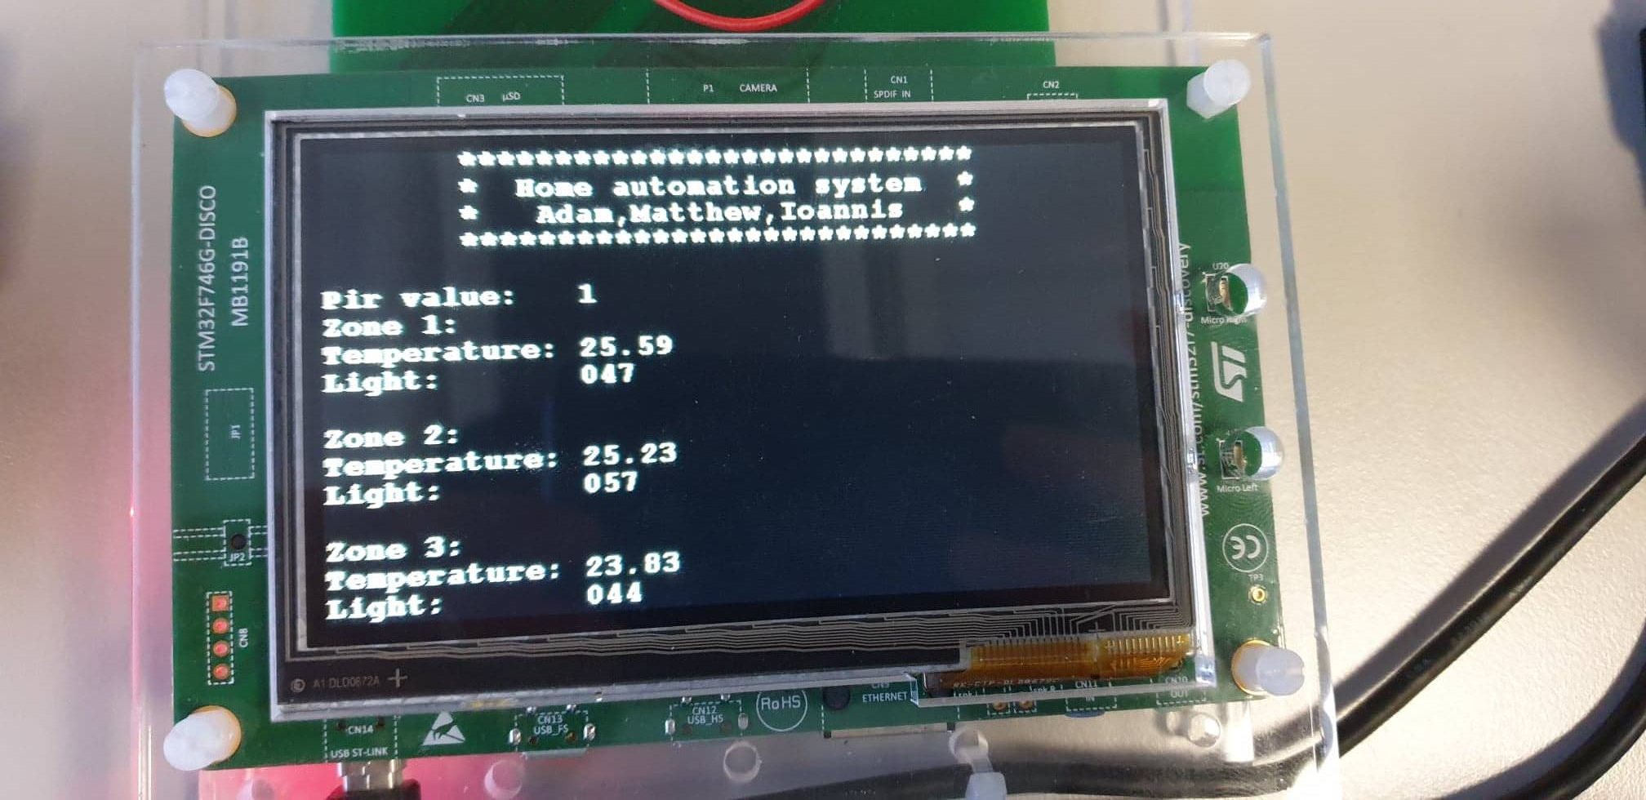
Insert picture of project working

Slide 5
What Steps did we take

Slide 6
What could have been done better
Hand it in on time (not entirely our fault)

Slide 7
Conclusions

